Slide 1
Kaldi ASR Research Team
Team: Tabitha O’Malley, Tamina Tisha, David Serfaty, Milan Haruyama, Adam Gallub
Customer: Dr. Jianhua Liu
Notes:
Adam

Slide 2
What is the
Kaldi ASR Toolkit?
Kaldi ASR Toolkit
ATC Training Data
Kaldi ASR Toolkit
Builds automatic speech recognition models
Automatic Speech Recognition
Conversion of speech to text
Training Data
30-hour ATC dataset
ASR Model
Speech recognition for ATC applications
ASR Model
Notes:
Adam 1:00

Slide 3
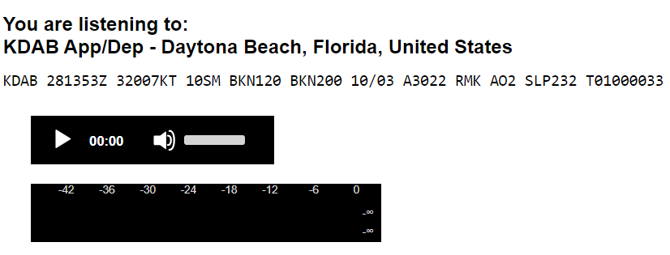
Background
Complexities in ATC communication requires extensive training
Instructor time
Lack of existing resources for students
RTube Web Application
Transcribe live ATC transmissions in real time
Notes:
Adam 2:00
Tisha worked on it :
Student pilots faced difficulties mastering the complex languages used in ATC communication requiring extensive training
Existing tools like Lice ATC provide some assistance but do not fully bridge the learning gap understanding and contextualizing spoken aviation language.
The RTube Web Application is developed to transcribe ATC transmissions into text in real time, facilities easier comprehension of aviation.
The ASR model in RTube is built using the Kaldi ASR tool kit, designated to handle the nuance of ATC communication
The project encountered various challenges due to complexity of the Kaldi Toolkit, especially the intricate nature of the ATC speech and the limitation in computing power.

Slide 4
Customer Needs
In Progress
Understanding current sample ASR model provided by Kaldi ASR Toolkit
Future Iterations
Adjust the sample ASR model using the 30-hour ATC dataset
Compare the performance of the trained models
Experiment with other models
Apply the best trained model
Experiment with callsign and frequency identification
Notes:
Tisha 3:00
Tisha worked on it
Mastering complex aviation language
Real time conversion of speech to text.
Understanding phrase usage in various scenarios
User friendly and accessible learning tool.
Precise recognition of diverse ATC communication
Affordable learning resource for student
Enhancing communication for safer flights

Slide 5
Major Requirements
Computer
Windows Subsystem for Linux (WSL)
Kaldi ASR Toolkit
Sufficiently powerful GPU
Sufficient amount of memory
WAV file as input
Contains spoken speech
Convert non-WAV files using FFMPEG utility
TXT file as output
Contains words transcribed from the WAV file
Notes:
Milan 4:00
Each requirement plays a role in the overall functionality and performance of the system - Tisha
Wav File Requirement
Fast Fourier Transform (FFT) Requirement
Mel - Frequency Cepstrum (MFC) & and Mel - Frequency Cepstrum Coefficients (MFCCs)
Gaussian Mixture Model (GMM) & Hidden Markov Model (HMM) requirement
Viterbi Decoder Requirement
Weighted Finite State Transducer (WFST) Requirement
Context- Dependency, Lexicon and Language model Requirement
Output Requirement

Slide 6
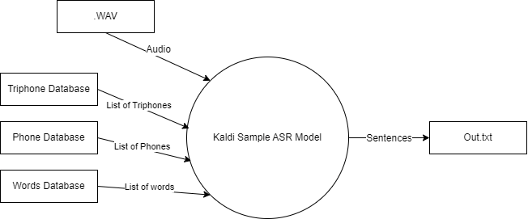
DFD Level 0: Context Diagram
Notes:
David 5:00

Slide 7
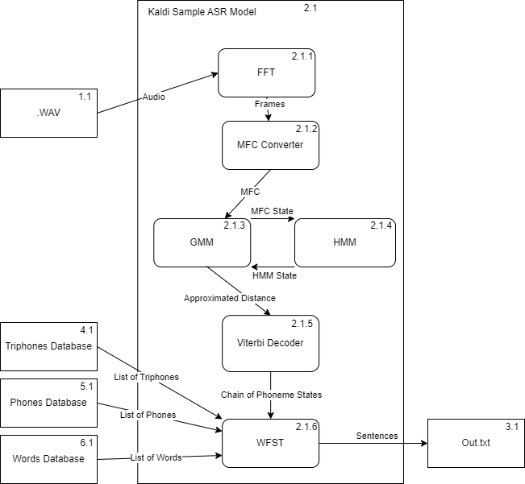
DFD Level 1
Sample ASR Model
Notes:
David 6:00

Slide 8
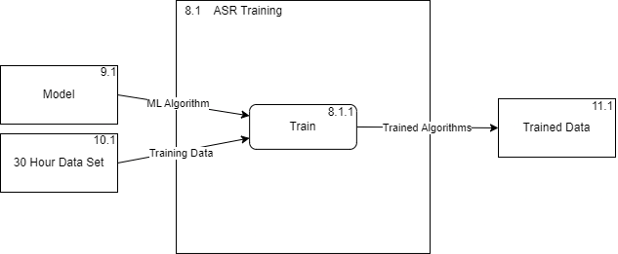
DFD Level 1 ASR Training
Notes:
David 7:00

Slide 9
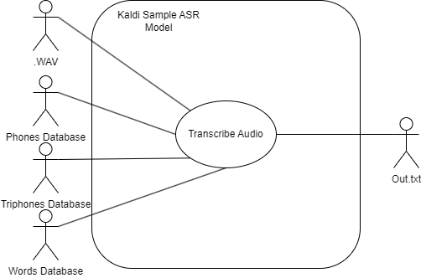
Use Case Diagram: Sample ASR
Notes:
Tabitha 8:00

Slide 10
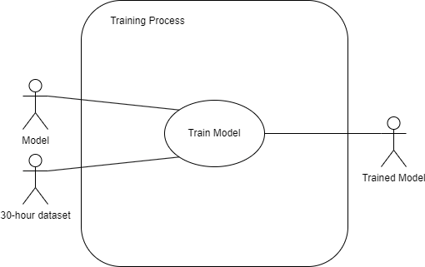
Use Case Diagram: Training Process
Notes:
Tabitha 9:00

Slide 11
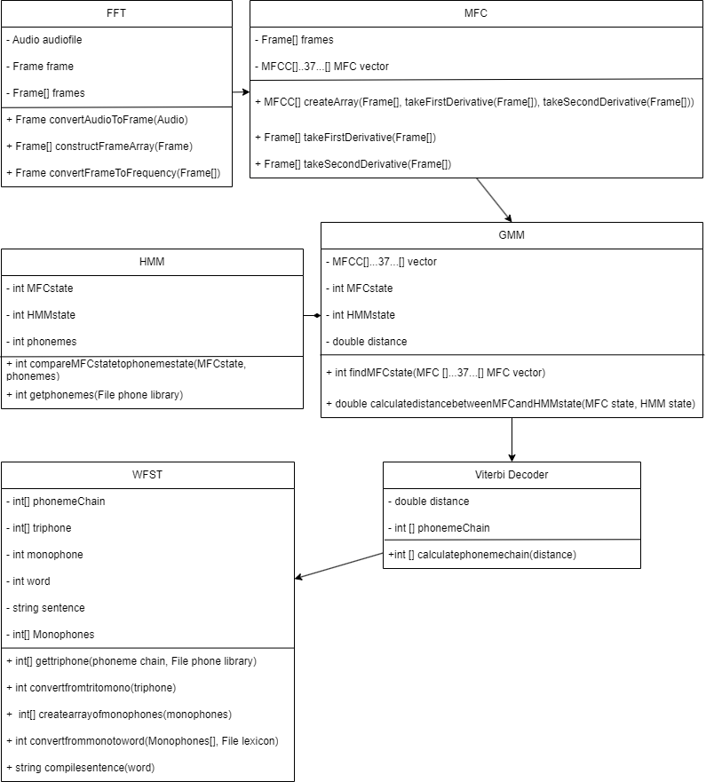
Class Diagram
Notes:
Tabitha 10:00

Slide 12
Future Testing
Input Testing
“The system shall return exceptions/errors if the input is a non-WAV file.”
“The system shall return exceptions/errors if there are multiple inputs.”
Accuracy Testing
Assess transcription accuracy of ASR model using predefined benchmarks (e.g., a minimum transcription accuracy of 80%)
Runtime Testing
Evaluate efficiency of ASR model based on processing time
Measure time taken by ASR model to process standard WAV file and produce output text file
Notes:
Tisha 11:30
tisha

Slide 13
Lessons Learned
Complexity of Speech Recognition
Black box that became slightly more translucent
Spaghetti code
Bad documentation
Nuances in human speech
Pronunciation (e.g., regional accents)
Articulation
Volume
Pace
Hardware Limitations
High performance requirements
Training speed dependent on GPU speed
Notes:
Milan 13:00
Tisha

Slide 14
Next steps
Fall 2023 | Spring 2024 | 202X | 202X | 202X | 202X
Understand current ASR model (on going process) | Adjust the model using the 30-hour ATC dataset | Compare the performance of trained models | Experiment with other models | Apply the best trained model | Experiment with callsign and frequency identification
Notes:
Milan 14:00

Slide 15
Questions?

